Slide 1
Deep learning & AdS/CFT
Hyejin Kim

Slide 2
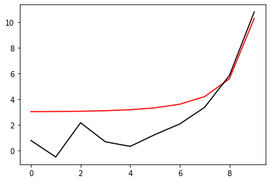
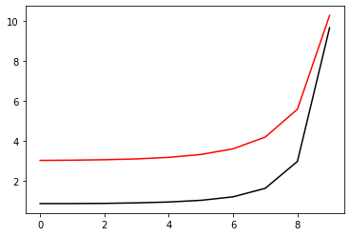
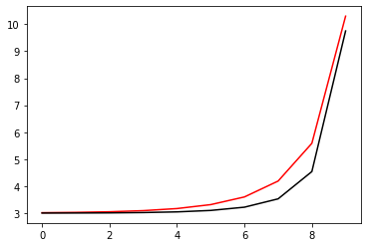
m^2= -1.4833055
m^2= -1.1425718
m^2= -1.0002805

Slide 3
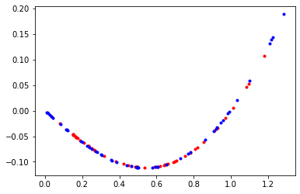

Slide 4
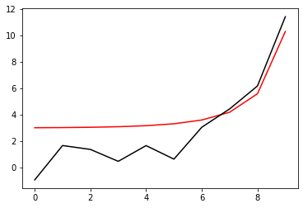
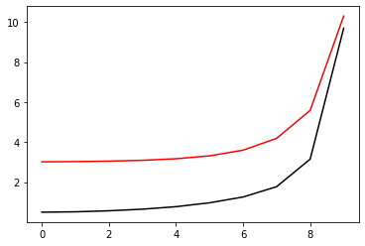

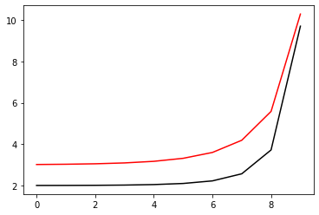
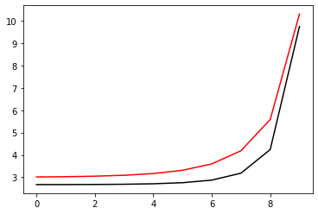
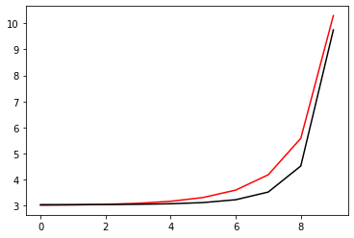
m^2= -1.3972933
lamda=1.7333493
m^2= -1.372015
lamda=1.7460442
m^2= -1.1158638
lamda=1.3604977
m^2= -1.0220963
lamda=1.0693017
m^2= -0.9026954
lamda=0.9003202
m^2= -0.9881687
lamda=0.9466647

